Slide 1

Digital Signature
Md. Rony Hossain
Roll: 1910876102
Dept: Computer Science & Engineering

Slide 2
What is a Digital Signature?
A Digital Signature is a cryptographic technique used to verify the authenticity, integrity, and origin of a digital message or document.

Slide 3
Use Of Digital Signature?
It is used to:
Prove that you sent a message or file
Make sure no one has changed it
Stop anyone from saying, "I didn’t send it"

Slide 4
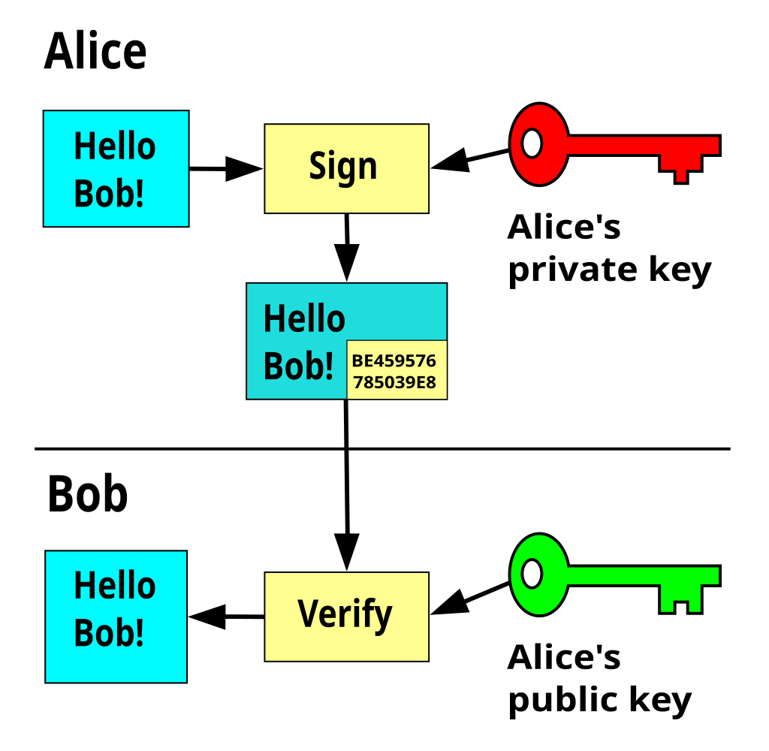
How does it work?

Slide 5
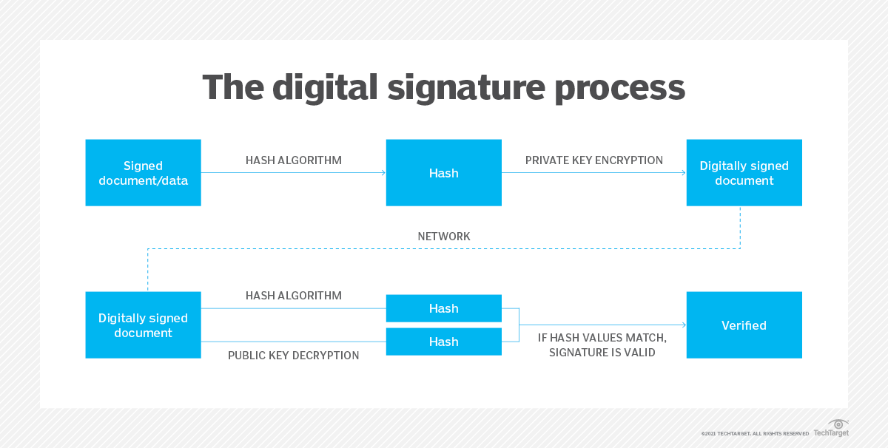

Slide 6
Digital Signature Process
Signing the Document (Sender’s Side)
Input: A document or data (e.g., a message, contract, file)
Hashing A hash algorithm creates a fixed-size summary of the document.
Encrypt the Hash The hash is encrypted using the sender's private key.
Attach Signature The original document and the digital signature are combined.

Slide 7
Sending Over the Network
The digitally signed document is sent to the receiver through a network (e.g., email, website, etc.)
Verifying the Signature (Receiver’s Side)
Hash Again The receiver applies the same hash algorithm on the received document to generate a new
hash.
Decrypt the Signature The receiver uses the sender’s public key to decrypt the digital signature, which gives the original hash created by the sender.
Compare Both Hashes
If both hashes match → ✅ The document is valid and unchanged.
If they don’t match → ❌ The document was tampered or not from the real sender.

Slide 8
Where is it used?
Signing PDFs (contracts, agreements)
Sending secure emails
Online banking
Software updates
E-voting systems

Slide 9
Limitations of digital signature
Private key can be stolen
Certificate can expire or be revoked
Needs special setup (PKI)
Requires technical knowledge
Not accepted everywhere

Slide 10
Thank You

